Slide 1
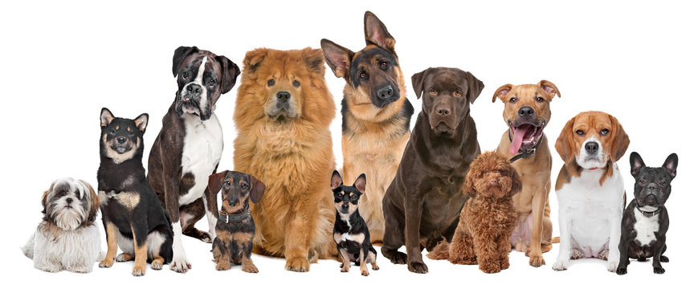
Predicting Dog Breeds
Third place submission

Slide 2
Strategy
Initially tried training a CNN from scratch - you can imagine how that went
Started looking into using an existing pre-trained model
Came across a tutorial on Kaggle that described Transfer Learning for Images along with this useful guide from Keras

Slide 3
How does transfer learning work?
Learned features from pre-trained neural network
Transfer to a new and different dataset to initialize training
Learning (backpropagation) only happens in the last layers initialized with random weights

Slide 4
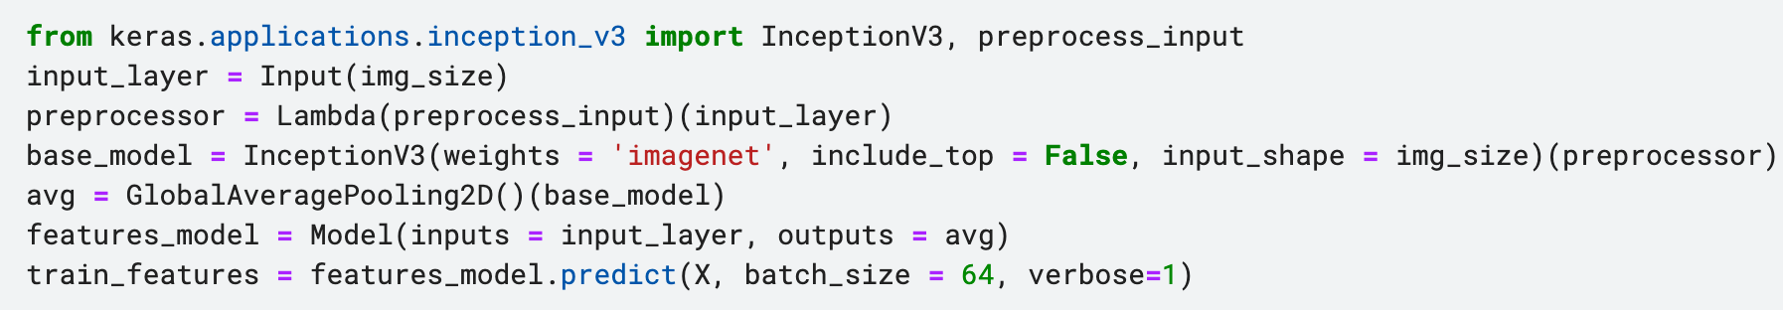
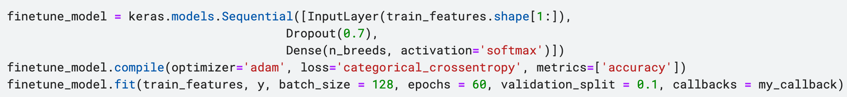
Using Inception V3
Inception V3 is a model that was developed at Google and pre-trained on ImageNet (1.4M images and 1000 classes)
Process:
Instantiate a base model and load pre-trained weights into it
Run new dataset through it and record the output of layers from the base model (feature extraction)
Use that output as input data for a new, smaller model

